Slide 1
Marine Corps Recruit Depot San Diego
As part of their final training event, Kilo Company, 3rd Recruit Training Battalion, took on the Bayonet Assault Course during the Crucible at Edson Range, Marine Corps Base Camp Pendleton, CA..
This iteration of the course was not the first time recruits were introduced to the event though. In the beginning of recruit training, Kilo Company was taught basic rifle techniques such as forward and vertical slash. After the class was completed, recruits ran through the back half of the course on Marine Corps Recruit Depot San Diego.
As the recruits pushed deeper and deeper into their recruit training cycle, they began to learn more techniques and competed in events such as Pugil Sticks. That event allowed the recruits to battle one another using the techniques they had acquired throughout training.
“We use the Bayonet Assault Course because it re-emphasizes everything the recruits had learned throughout training,” said Gunnery Sgt. Juan L. Chantaca, drill instructor, Platoon 3223. “Each time they ran the course, something was added, and now is when they apply everything.”
The last time recruits conducted the course was much different because this time, they integrated fire team movements and bayonet techniques that they learned during Field Week, or Week 7, of recruit training, explained Chantaca.
While running the course, recruits wore flak jackets, their load bearing vest, carried an M-16 A4 Service Rifle and wore their Kevlar helmets. The course consists of obstacles such as monkey bridges, crawling tunnels, logs and tires, which simulates where recruits needed to use bayonet techniques.
According to recruit Brandon M. Hurd, Platoon 3223, the biggest challenge was pushing past how fatigued his body was. “We had only a small amount of sleep last night.” “Everything we do is more difficult knowing we have had a small amount of food and sleep.”
Company K recruits have completed the final Bayonet Assault Course of recruit training but will face more training in the future. “We gave them the basic tools that are needed for further instruction,” said Chantaca. “When they are Marines and move on to the School of Infantry, they will learn more advanced techniques and build off of what they learned here.”

Slide 2
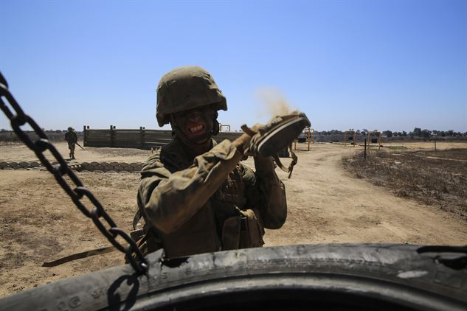
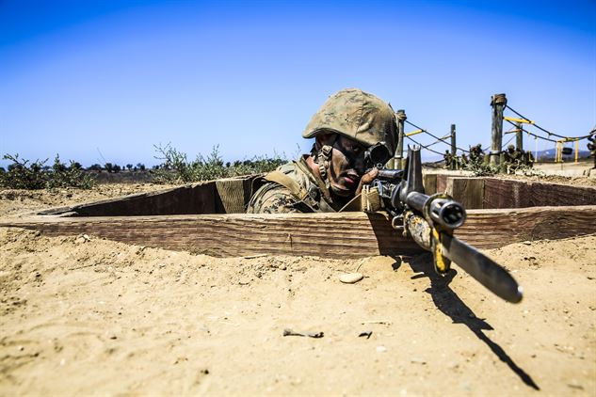
A recruit from Kilo Company, 3rd Recruit Training Battalion, executes a vertical butt-stroke against a simulated enemy at Edson Range, Marine Corps Base Camp Pendleton. The recruits ran through a similar course multiple times throughout recruit training; each time they integrated new techniques and lessons they learned throughout training.
Recruit provides cover while his fire team advances their position during the Bayonet Assault Course at Edson Range, Marine Corps Base Camp Pendleton.

